Slide 1
Can Job Details Predict Salary in the Age of AI?
DATA 4380 · DATA PROBLEMS
AI Impact on Jobs & Salaries, 2020–2026
Quynh Huong Vo · Maryam Irfan · Ruth Slaughter · Subhi Paulraj
Instructor: Dr. Masoud Rostami · October 12, 2026
Notes:
P1, ~0:45. Introduce team and the four parts; each person owns one part (about 5 minutes each). Fill in names and date.

Slide 2



Background and Motivation
Generative AI is changing the tasks we complete in our jobs. What does the pay data look like?
The context
The data
Who benefits
ILO study (Gmyrek et al., 2025) scores occupations 0–1 on exposure to generative AI
71,913 self-reported salary records for data and AI roles, 2020–2025
Job seekers, employers and analysts who want to see what drives pay
Notes:
The notebook links our job roles to exposure scores from the ILO paper; the main modeling goal is predicting a salary tier.

Slide 3
Problem Statement and Objectives
Can job, location and company details predict a record's salary tier, and does AI exposure add anything?
Explore and clean the data, then build a leak-safe baseline for salary tier
TARGET
salary_in_usd, binned into four quartile tiers
TASK
4-class classification: Low, Lower-Mid, Upper-Mid, High
SUCCESS
Beat the 25% majority-class guess; compare models on accuracy, precision, recall and F1
1
Compare the baseline with nonlinear models: Random Forest and Gradient Boosting
2
Test whether the ILO AI-exposure score adds predictive signal
3
Notes:
Salary is continuous, so we cut it into four quartile tiers to use classification metrics. These three objectives are answered again on the Key Findings slide.

Slide 4
Isco_group_hint
Our dataset has a special variable based off a study to further examine AI’s impacts on jobs.
This variable was derived from the study of ILO’s Generative AI and Jobs paper by Gymrek et al. (2025), exploring how different careers can be affected by generative AI.
The ”isco_group_hint” column identifies AI exposure on a scale of 0-1, where a higher score indicates a higher chance of generative AI being present in the job.
Based off the study, higher scores show how a job’s tasks can be done or helped by generative AI. Grouped jobs had different exposure levels based on their scores.
Isco_group_hint does not add new information, as its value is a bridge to the study’s exposure scores; it is not a standalone predictor.
Notes:
International Labor Organization

Slide 5
How AI Exposure Was Attached
Manual, approximate mapping; scores averaged from Gmyrek et al. (2025)
ISCO group | Role family | Score | Rows
Mathematicians, actuaries, statisticians | Data Scientist | 0.561 | 7,216
Software and applications developers | Data Engineer, ML Eng., AI Eng., AI Architect, CV, NLP | 0.527 | 12,475
ICT service managers | Analytics Manager | 0.440 | 495
Business services managers | Data Analyst | 0.419 | 8,335
Physical and earth science professionals | Research Scientist | 0.411 | 2,852
Covers 31,373 of 71,913 rows (44%); the other 40,540 rows have no score.

Slide 6
PART 1 · PROBLEM & DATA
Our Workflow
We worked through the data science pipeline to answer the research question.
BASELINE STAGE
Raw data
›
Data understanding
›
Minimum cleaning
›
Train / test split
›
Baseline model
MODELING STAGE
Additional preprocessing
+ ILO score
›
Model selection
(RF, GB)
›
Evaluation
(same metrics)
›
Hyperparameter tuning
(future work)
›
Final model:
Logistic Regression
Solid boxes were completed in this project; the dashed box was not done.
Notes:
Walk the pipeline left to right. The orange box is the baseline everything is compared to; the navy box is the final model; tuning was not done.

Slide 7
Dataset and Data Understanding
One row per salary record; the target is salary in USD
71,913
17
2020–2025
salary_in_usd
rows
columns
years covered
target variable
Numeric
Categorical
Free text
Quality
work_year, remote_ratio, salary_in_usd
experience_level, employment_type, employee_residence, company_location, company_size, role_family
job_title (422 distinct values)
Only isco_group_hint has gaps (56% missing). 2.4% of salaries are flagged outliers, kept in the data.
Notes:
Only isco_group_hint has missing values, because it only covers 5 of 11 role families, so nothing was imputed in the baseline. Tiers are balanced by construction.

Slide 8
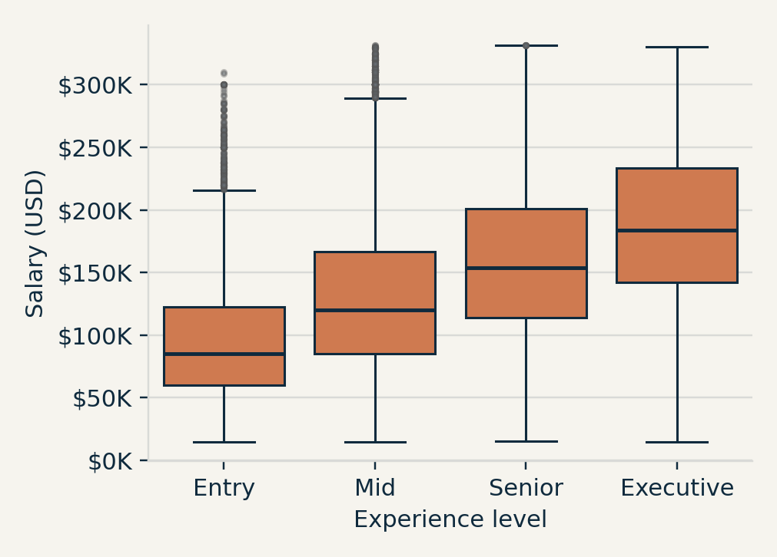
Salary Distribution
Right-skewed, and salary rises with seniority
Mean $151K, median $139K, skewness 1.48 (full data). Outliers are removed for plotting only and never used as a feature.
Notes:
Right skew is typical of salary data. Pay rises with experience level and the spread widens with seniority.

Slide 9
Average Salary by Role Family
Architect and research roles pay most; Data Analyst pays least
Top
AI Architect, Analytics Manager, Research Scientist and ML Engineer
Middle
“Other / Unclassified” is 56% of rows and mixes many job titles, so it is not one role
Lowest
Data Analyst, about $108K
Notes:
NLP (19 rows) and Computer Vision (134 rows) are small groups, so read those bars cautiously.

Slide 10
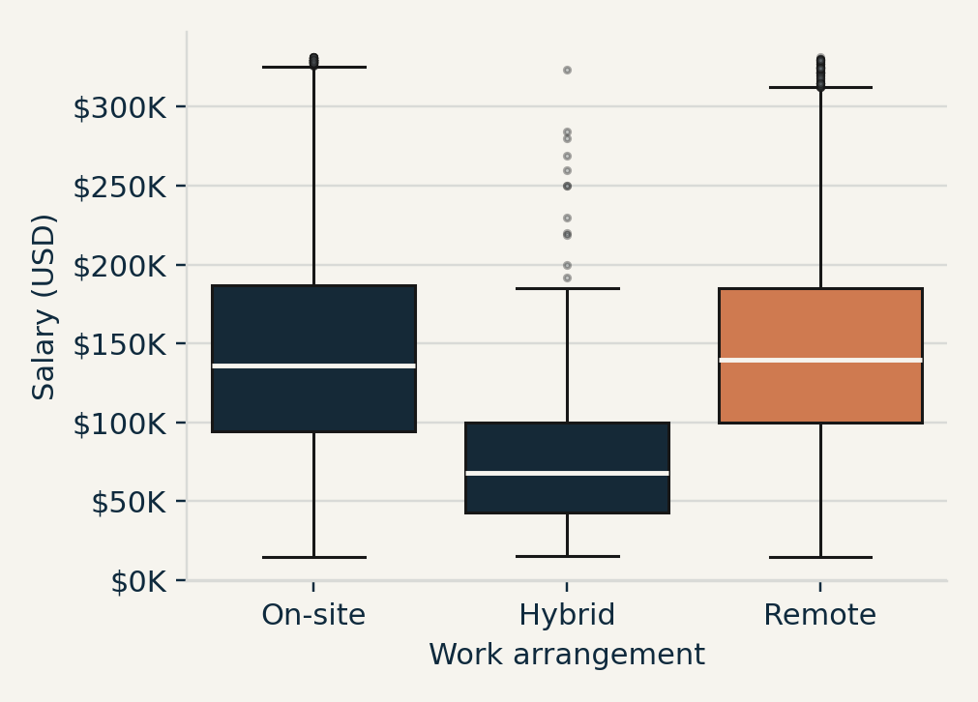
Salary by Work Arrangement
Hybrid looks underpaid, but its group is tiny and junior-heavy
$79K
$145K
Hybrid mean (324 rows)
On-site and Remote means
Hybrid has few Executives (11 of 324), so the gap reflects who is in the group, not the work style.
Notes:
On-site mean about $144.8K, Remote about $145.5K. Top Hybrid roles: Data Scientist, Other, Data Analyst.

Slide 11
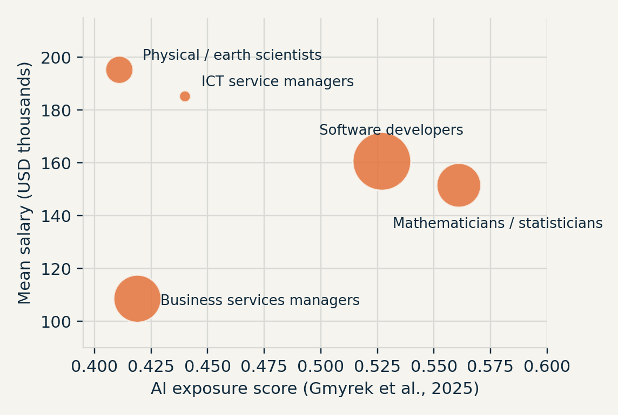
Exposure, Hybrid and Correlation
What we expected to matter but did not, and one result that looks odd
You would expect a negative relationship between these two variables, so as AI exposure increases salary decreases.
No clear link between AI exposure and pay across the 5 groups. Exploratory only.
Notes:
Exposure vs salary uses only five group averages, so it only shows how the join works. Bubble size is the number of records.

Slide 12
Data Leakage Audit: What We Removed and Why
Five checks before any model sees the data
Column(s) | Action | Reason
salary, salary_currency | Drop | Rows with USD currency were identical
salary_outlier_flag | Drop | Computed from salary_in_usd
experience_level_label, employment_type_label, work_mode | Drop | Duplicates of coded columns
job_title (422 values) | Drop | Captured by the 11-group role_family
isco_group_hint | Drop | 56% missing; repeats role_family
Left with 8 features: work_year, experience_level, employment_type, employee_residence, remote_ratio, company_location, company_size, role_family
Notes:
salary equals salary_in_usd for 100% of USD rows, so keeping it would let the model read the answer.

Slide 13
Minimum Preprocessing and Split
Only what the baseline cannot run without; all fitting uses training data only
1
2
3
4
Random 80/20 split
Quartile salary tiers
One-hot encode
Standardize numerics
57,530 train, 14,383 test, seed 42
Cut points from training data only: $96,000, $138,750, $190,200
6 categorical features become about 217 columns with the scaled numerics
work_year and remote_ratio put on a common scale
Tiers are 25% each in training and about 25% in test, so a plain random split is enough.
Notes:
Encoding and scaling are fit inside a pipeline on training rows only. Test salaries outside the training range fall into the end tiers.

Slide 14
Baseline Models and Results
Logistic regression nearly doubles the majority-class accuracy
Why these baselines
The dummy sets the floor (about 25%). Logistic regression is simple and interpretable.
Why these metrics
Macro averages weight all four tiers equally.
Result
Accuracy 0.249 → 0.418; macro F1 0.100 → 0.392
Notes:
Dummy: accuracy .249, macro precision .062, recall .250, F1 .100. Logistic regression: accuracy .418, precision .419, recall .417, F1 .392. Same test set for both.

Slide 15
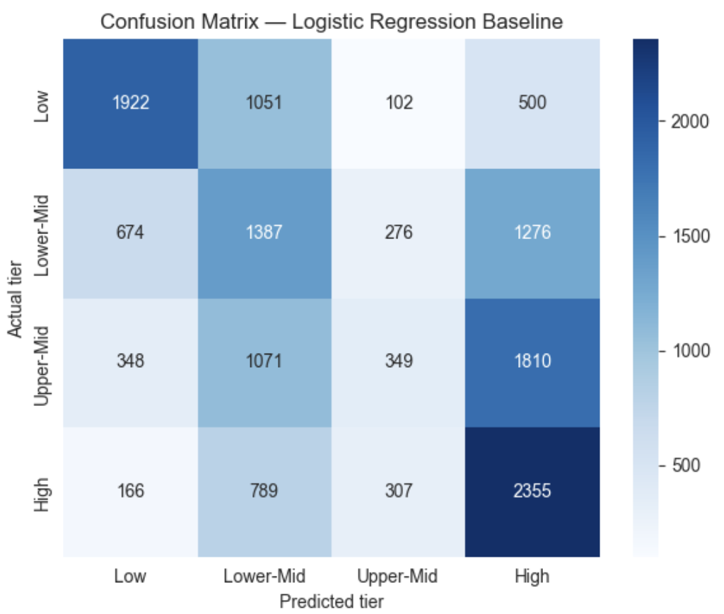
Baseline Error Analysis
Upper-Mid is the hardest tier; the model leans toward High
Recall by tier
High
65%
Low
54%
Lower-Mid
38%
Upper-Mid
10%
~ 1,810 of 3,613 Upper-Mid records are predicted as High most of the time.
~ Errors are not only in neighbor tiers (1,276 Lower-Mid predicted High).
Notes:
Per-tier values are computed from the confusion matrix. Importance of experience_level and role_family is a hypothesis from EDA, not yet tested.

Slide 16
Model Selection: Challengers to the Baseline
Each model tests a different idea, and all are scored on the same held-out test set
Random Forest
Boosting & XGBoost
Logistic + ILO score
300 trees, balanced class weights.
Why: captures nonlinear interactions between role, location and seniority.
Limit: harder to interpret.
scikit-learn defaults; XGBoost with 400 trees, depth 6.
Why: each tree fixes the last one's errors; XGBoost handles thousands of sparse title features quickly.
Limit: slower and can overfit.
Adds the Gmyrek exposure score.
Why: directly tests the project's AI question.
Limit: only 5 distinct values, 56% missing.
Setup: every model, including the baseline, is re-scored on one stratified 80/20 split (seed 42, 14,383 test rows), with tier cut-offs from training data only. Design choices use 5-fold CV on training data; the test set is used once.
Notes:
P4, ~1:00. Each challenger tests one idea. Random Forest: do interactions between role, location and seniority matter? Boosting: a stronger nonlinear learner; XGBoost is added because it handles the sparse job-title features used later. Logistic + ILO: does AI exposure add signal? Trees need no scaling, but one shared pipeline (one-hot + scaling) keeps the comparison fair. Important change from the first draft: the baseline and challengers were originally scored on different splits with different averaging, so I re-scored every model, including the baseline, on one split with one set of metrics.

Slide 17
Additional Preprocessing: Adding AI Exposure
Attach the ILO score to each row, then handle the gaps without leakage
What we did
Missing values
Leakage guard
Mapped each isco_group_hint to its averaged ILO exposure score (0.411 to 0.561). 31,373 of 71,913 rows matched.
40,540 rows have no score. Median imputation plus a missing-indicator column lets the model tell imputed from real.
The imputer and scaler sit inside the pipeline and are fit on training rows only.
Result: no gain. On the same test split, accuracy stays 0.417 and ROC-AUC stays 0.685. Each role family maps to exactly one score, so the score only repeats role_family, which the model already uses.
Notes:
P4, ~0:50. This is the additional-preprocessing step. We attached the ILO score, imputed the 56% of rows with no score using the training median plus a missing-indicator column, and kept the imputer and scaler inside the pipeline so nothing is fit on test data. Result: identical scores. The reason is structural: every role family has exactly one exposure value, so the score is a relabel of role_family. We report the step even though it did not help.

Slide 18
Why Every Model Ties: An Information Ceiling
The 8 features cap accuracy at 0.428, and the models already sit at about 0.42
2,201
distinct feature profiles among 57,530 training rows
0.428
best possible accuracy with these 8 features
0.490
ceiling once the raw job title is added
Implication: tuning cannot pass this ceiling, so we did not run a hyperparameter search. We need new information, not a bigger model.
Notes:
P4, ~1:15. KEY SLIDE. Left: on the same split, the four earlier models are tied, about 0.42 accuracy and 0.68 ROC-AUC. Right: why. The 57,530 training rows collapse into only 2,201 distinct combinations of the 8 features, and people with identical features report very different salaries. If a model memorised the most common tier for every combination it would still only reach 0.428. Our models are at 0.417 to 0.419, so they are limited by information, not by the algorithm. That is also why we did not run a hyperparameter search: tuning cannot pass that ceiling. Adding the raw job title raises the ceiling to 0.490, which is the next slide.

Slide 19
Feature Engineering: Bring Back the Job Title
New information, not a more complex model, is what moves performance
Keyword flags: senior / staff / lead, manager / director / head, junior / associate / intern
TF-IDF on the full title: weights for words and word pairs, e.g. “machine learning”, “data analyst”
Not leakage: the title is known before the salary; it was dropped earlier only as a duplicate of role_family
Result: keywords add little; the full-title TF-IDF lifts CV accuracy 0.411 → 0.441 and macro F1 0.395 → 0.423.
Notes:
P4, ~1:00. job_title was dropped during preprocessing because role_family is derived from it, but role_family puts 56% of rows into 'Other'. It is not leakage: the title is known before the salary and appears on every job posting. We used it two ways: three keyword flags (senior, manager, junior words), and TF-IDF on the full title, which turns each title into weights for words and word pairs. Measured with 5-fold cross-validation on training data only, never the test set: keywords help a little, TF-IDF gives the big jump. The fold-to-fold spread is under 0.01, so the gain is real.

Slide 20
Model Comparison on the Same 14,383 Test Rows
Title features beat every earlier model on every metric
Model | Accuracy | Precision | Recall | F1 | ROC-AUC | Within 1 tier
Dummy (most frequent) | 0.250 | 0.063 | 0.250 | 0.100 | 0.500 | 0.500
Logistic Regression (baseline) | 0.417 | 0.417 | 0.417 | 0.403 | 0.685 | 0.792
Random Forest | 0.411 | 0.408 | 0.411 | 0.399 | 0.678 | 0.786
Gradient Boosting | 0.419 | 0.417 | 0.419 | 0.398 | 0.686 | 0.786
Logistic + ILO exposure | 0.417 | 0.417 | 0.417 | 0.403 | 0.685 | 0.792
Logistic + title features (final) | 0.447 | 0.433 | 0.447 | 0.429 | 0.713 | 0.811
XGBoost + title features | 0.444 | 0.427 | 0.444 | 0.425 | 0.714 | 0.812
Ridge log-salary → tier | 0.405 | 0.480 | 0.405 | 0.404 | n/a | 0.888
Precision, recall and F1 are macro-averaged. Darker cells: best value in each column.
Is the gain real? Bootstrap: +0.026 F1, 95% CI [+0.019, +0.032]. 5-fold CV: F1 0.395 → 0.423. Trained on 2020–24, tested on 2025: accuracy 0.409 → 0.440.
Notes:
P4, ~1:15. Every model, same 14,383 test rows, same metrics, macro-averaged. The final model is Logistic Regression with title features: accuracy 0.417 to 0.447, F1 0.403 to 0.429, ROC-AUC 0.685 to 0.713. XGBoost ties it, which again shows the gain comes from information, so we keep the simpler, interpretable model. The Ridge row predicts log-salary and then cuts it into tiers: lower exact accuracy but the most predictions within one tier (0.888), and a dollar error of about $46K. ROC-AUC is n/a for Ridge because it outputs a salary, not tier probabilities. Bottom bar: the gain is real. Bootstrap on the test set gives a 95% interval of +0.019 to +0.032 for macro F1, and training on 2020-2024 then predicting 2025 still improves accuracy 0.409 to 0.440.

Slide 21
What the Model Learned, and Where It Fails
Job title, experience and location drive predictions; the crowded middle tiers are hardest
Title words: “engineering manager”, “quantitative researcher”, “ML” push toward High; “analyst”, “BI”, “specialist” push toward Low. Association, not cause.
Notes:
P4, ~1:15. Left: SHAP values for the XGBoost model's probability of the High tier, summed back to each original column. Job title is the biggest driver, then experience level, then where the employee lives and where the company is. Permutation importance on the logistic model gives the same top three, so two methods on two models agree, and the order is plausible: pay depends on what you do, how senior you are, and where. Right: accuracy by actual salary is U-shaped, about 89% below $50K and 82% above $300K, but only 18-33% in the $96K-$190K middle tiers, which are narrow slices of the densest part of the distribution. Upper-Mid earners are often pushed up into High. Most mistakes are one tier off: 81% of predictions are within one tier. Importance shows association, not cause.

Slide 22
Key Findings, Tied Back to Our Objectives
1. Baseline
2. Better models
3. AI exposure
A leak-safe logistic baseline lifts accuracy from 25% to 41.7%.
RF and boosting tie the baseline: the 8 features are the limit. Adding the job title lifts accuracy to 44.7% and ROC-AUC to 0.713.
The ILO score changes nothing: it is a relabel of role_family, so this data cannot test the AI–pay link.
Answer to our question: job details predict salary tier modestly: 45% exactly right and 81% within one tier, against 25% by chance. Job title, seniority and location matter most.
Notes:
P4, ~1:00. Back to the three objectives on the Problem slide. One: the leak-safe baseline works, 25% to 41.7%. Two: nonlinear models did not help because the features hit a ceiling; new information from the job title did. Three: the ILO score adds nothing here, because it never varies within a role, so this data cannot test the AI-pay link; that is a finding about the data, not proof that AI exposure is unrelated to pay.

Slide 23
Limitations, Conclusion and Future Work
Limitations
What it means
Next steps
Self-reported salaries; 84% US-based, 92% from 2024–25
Four tiers hide wide pay ranges within each tier
Free-text titles vary between companies
One exposure score per role family
A rough benchmark, not a pay calculator
Reliable at the extremes, weak in the middle tiers
Importance shows association, not cause
Match titles to detailed ISCO codes so exposure varies
Ordinal models that respect tier order
Cost-of-living adjustment for non-US pay
Refresh tier cut-offs each year
Notes:
P4, ~1:00. Be honest about limits: self-reported, mostly US, mostly 2024-25; four tiers hide wide pay ranges; titles are free text. In practice this is a rough benchmark, not a pay calculator, and the middle tiers are the least reliable. Next steps follow directly from the findings: give the exposure score real variation by matching titles to detailed ISCO occupations, use models that respect tier order, adjust non-US salaries for cost of living, and refresh tier cut-offs each year because salaries drift upward.

Slide 24
References and Questions
foorilla. (2025). ai-jobs-net-salaries [Data set]. GitHub. CC0 1.0.
Gmyrek, P., Berg, J., Kamiński, K., Konopczyński, F., Ładna, A., Nafradi, B., Rosłaniec, K., & Troszyński, M. (2025). Generative AI and jobs: A refined global index of occupational exposure (ILO Working Paper 140). International Labour Office. https://doi.org/10.54394/HETP0387 (CC BY 4.0)
Pedregosa, F., et al. (2011). Scikit-learn: Machine learning in Python. Journal of Machine Learning Research, 12, 2825–2830.
Chen, T., & Guestrin, C. (2016). XGBoost: A scalable tree boosting system. Proceedings of KDD 2016, 785–794.
Lundberg, S. M., & Lee, S.-I. (2017). A unified approach to interpreting model predictions. Advances in Neural Information Processing Systems, 30.
Software: pandas, matplotlib, seaborn, shap.
Thank you. Questions?
Notes:
All, ~0:30 plus Q&A. Keep this slide up during questions.

Slide 25
Logistic regression, per-tier report
BACKUP · MODEL DETAIL
Tier | Precision | Recall | F1
Low | 0.40 | 0.65 | 0.49
Lower-Mid | 0.62 | 0.54 | 0.58
Upper-Mid | 0.32 | 0.38 | 0.35
High | 0.34 | 0.10 | 0.15
Macro average: precision 0.42, recall 0.42, F1 0.39 on 14,383 test rows.
Backup · Baseline classification report
Notes:
Backup. Use if asked why accuracy alone is not enough: High-tier recall is only 10%.

Slide 26
Category balance
BACKUP · DATA DETAIL
Variable | Dominant category | Share
experience_level | Senior | 52.4%
employment_type | Full-time | 99.0%
company_size | Medium | 97.5%
remote_ratio | On-site (0) | 75.2%
role_family | Other / Unclassified | 56.4%
work_year | 2025 | 53.2%
Backup · Notebook variable-balance check
Notes:
Backup. Heavy imbalance means rare categories (Executive, Small company, Hybrid) give models little data.

